Slide 1
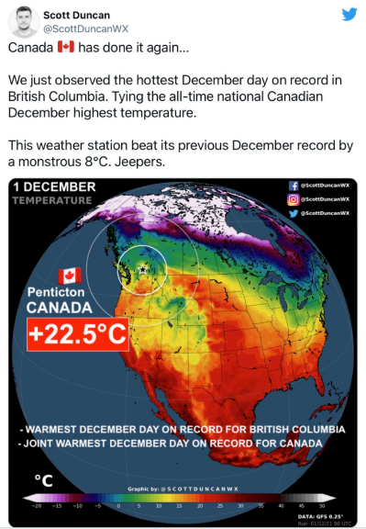




Tweet Data Pipeline
A real-time data pipeline for querying and visualizing tweets
Presented by
Devashish Kulkarni Mili Gera
Heesuk Jang
Matt Whittaker
W205 Data Engineering
MIDS, UC Berkeley
Fall 2021
Notes:
Matt

Slide 2
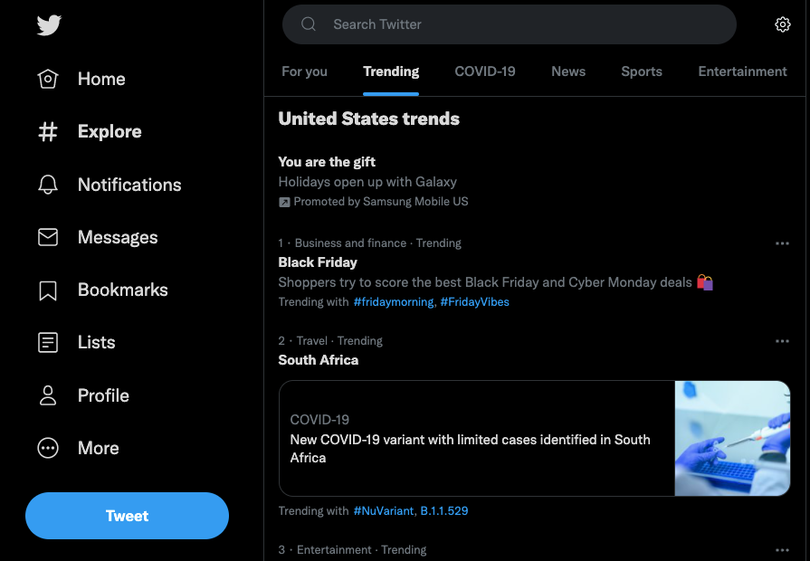



OVERVIEW
Problem: Twitter has become a prominent source of real-time content, yet lacks the ability to perform Tweet analytics beyond the limited web user interface
Solution: Create a data pipeline to gather tweets, fully customizable based on filtering rules and criteria
On-demand
Customizable
Data available on-demand from the Twitter API using python, with messages consumed and produced through Kafka and Spark
Tweets can be aggregated by hashtag, location or topic
Analytics
Structured Data
Robust data processing allowing for SQL to be used for advanced analytics and querying
Tweets are compiled into standardized format for
aggregation into logical dataframe based structure
Application: Customized filtering rules and criteria for Climate Change topics on Twitter
Notes:
Matt
For this project we built a data pipeline from Twitter.
Orginally we thought it would be interesting to learn more about what is going on right now for climate change topics, given that there are multiple conferences, multiple key figures, and lots of concurrent work going on at once. We thought about the best way to aggregate this disparate data set, and landed on twitter as the best source of real-time content and blogging about Climate Change.
Twitter, we quickly realized, lacks any sort of data aggregation or analytical capabilities, instead limited to a webpage with “trending” topics but limited to point and click exploration based on Twitter’s algorithm.
Our solution for this was to create a data pipeline to gather the tweets, but fully customizable based on our on rules and criteria
-On-demand: we chose to batch this just for a proof of concept, Twitter’s free API has some hit limits so we set up in batch to avoid exceeding the limit
-Customizable: fully customizable based on hashtags, locations, or trending topics from specific accounts. The really cool thing about this pipeline is that it could be applied to sports, politics, stock markets, or any other domain where there are real-time processes
-Analytics: Data set up in SQL for analytics and querying
-Structured data: a standardized framework puts this into structure to make this repeatable and scalable

Slide 3
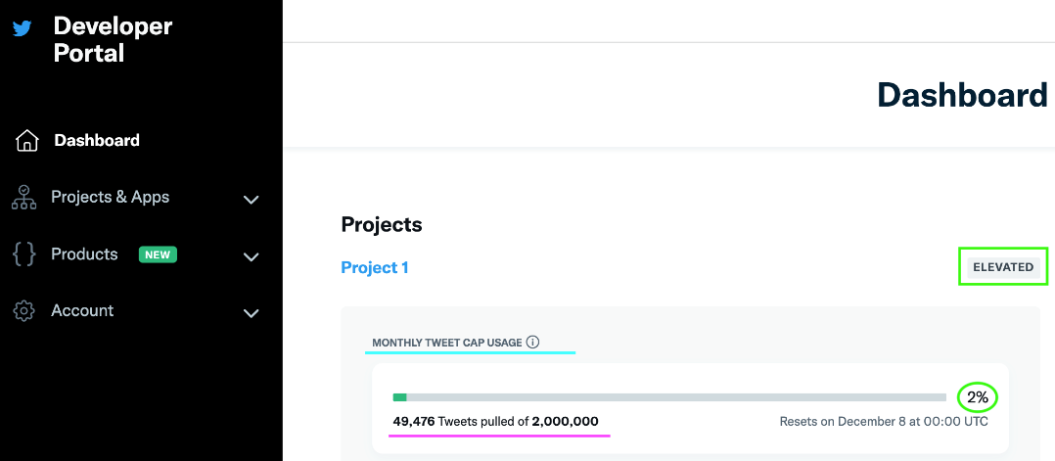




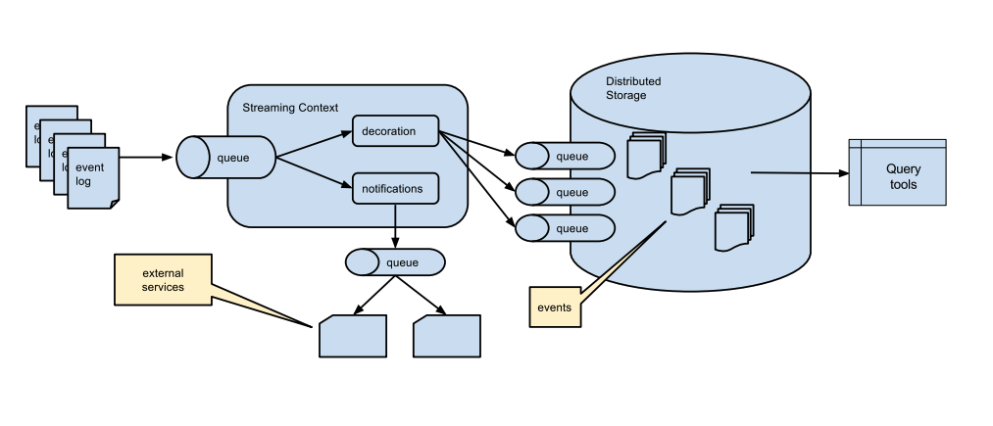
DATA PIPELINE
STEP 1: Twitter Developer Account Setup
STEP 2: Filtered Stream Endpoints
STEP 3: Read Tweets
POST /2/tweets/search/stream/rules
Bearer Token
GET /2/tweets/search/stream
STEP 4: Tweets Ingestion and Loading in relation to Kafka Topic
STEP 5: ETL, Data Storage, and Data Querying
Twitter API connection using Bearer Token
Spark Consumer
Jupyter Notebook Setup using Presto
Kafka Producer + Topic
HDFS & Hive Tables
Notes:
Mili

Slide 4


TOOLS
Tweet streaming (via Twitter API) tools incorporated in Google Cloud Platform (GCP) and Jupyter
D
Used to create containers of various services required to construct the data pipeline
Docker Compose
Z
Zookeeper
Used to track the status of nodes in the Kafka cluster and maintain a list of kafka topics and messages.
Twitter API
K
Kafka
Used as a broker to receive messages produced by Twitter and store them in a topic
S
Used to consume messages stored in a Kafka topic, perform the ETL transformations and store them into HDFS as parquet files
Spark
H
Distributed files system from Hadoop that is used to store the tweet streaming data in tables
HDFS
P
Presto / Hive
Used to query the tables stored in HDFS
Notes:
Mili

Slide 5

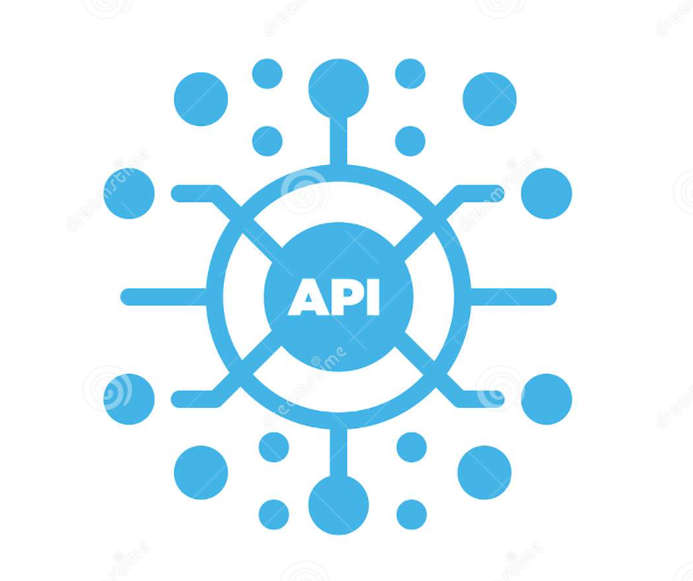

FILTERED STREAM REQUEST
Tweet object
Twitter API rules
Requested fields
Basic Building Block of all things Twitter
Root level ‘fields’
id
text
created_at
Parent to children objects
user
media
place
Rules used for this analysis:
Tweets from leading climate change activist organizations
Includes hashtags or key phrases linked to climate change
Accounts that mention (@) a leading organization
Requested fields in this analysis:
Tweet fields
Root level fields
Metrics (likes, retweets, replies)
User fields
Name
Username
Location
Place fields
Country
Country code
+ BEARER_TOKEN
Streaming Data
Notes:
Deva
Tweet object is the basic building block of twitter.
Contains several root level fields
Contains several child object
API data stream is specified by two parameters – rules and fields
Rules filter tweets, fields select data we want
Examples rules and fields we use
Final ingredient is bearer token – from twitter after developer account in approved.

Slide 6
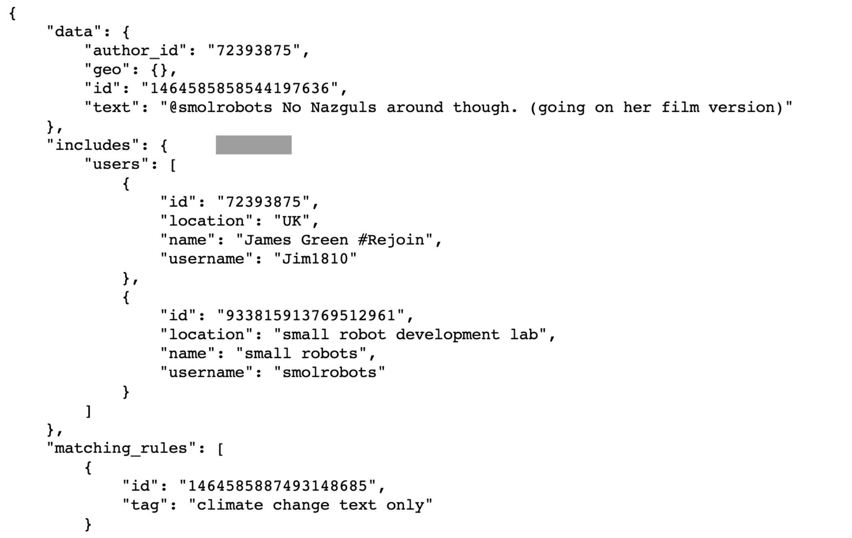

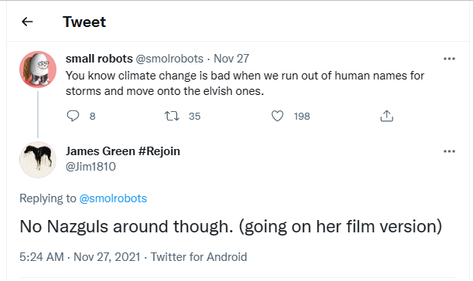
Notes:
This is how a message looks like
Nested Json with multiple levels
Some levels may have different number of items, these have to be unrolled using spark
Each field ends up in a different column

Slide 7


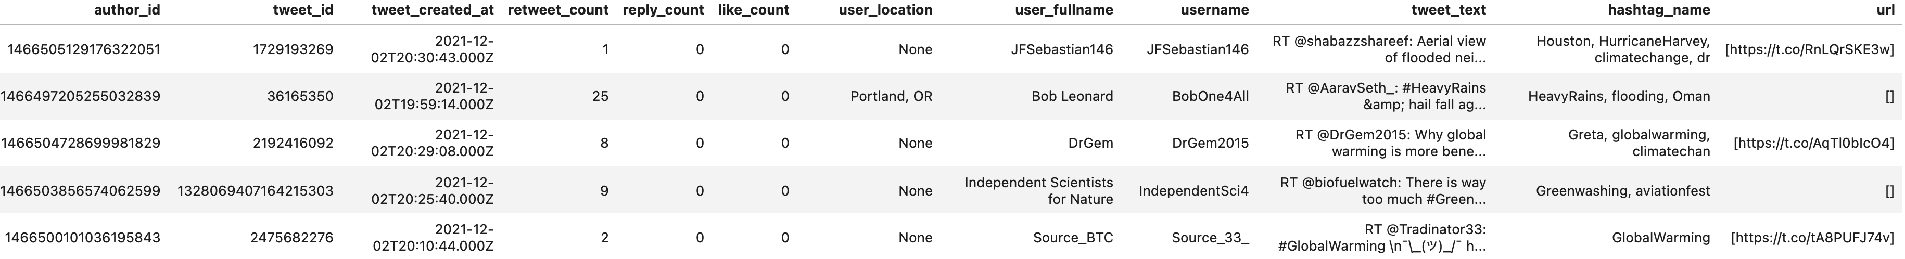
FINAL TABLE TO BE QUERIED using PRESTO
Selected Tweet Metadata
Author ID
Tweet ID
Tweet Created At
Retweet Count
Reply Count
Like Count
User Location
User Fullname
Username
Tweet Text
Hashtag Name
URL
To HDFS through Data pipeline
Converted to external table by Hive
Queried by Presto and loaded in pd.DataFrame
Notes:
Deva
Twwets go through the pipeline and land in HDFS, use hive to create external table that can be queried by Presto. Output of presto query loaded into a pandas dataframe that is ready for vizualization

Slide 8
PIPELINE DEMO
Notes:
Heesuk

Slide 9
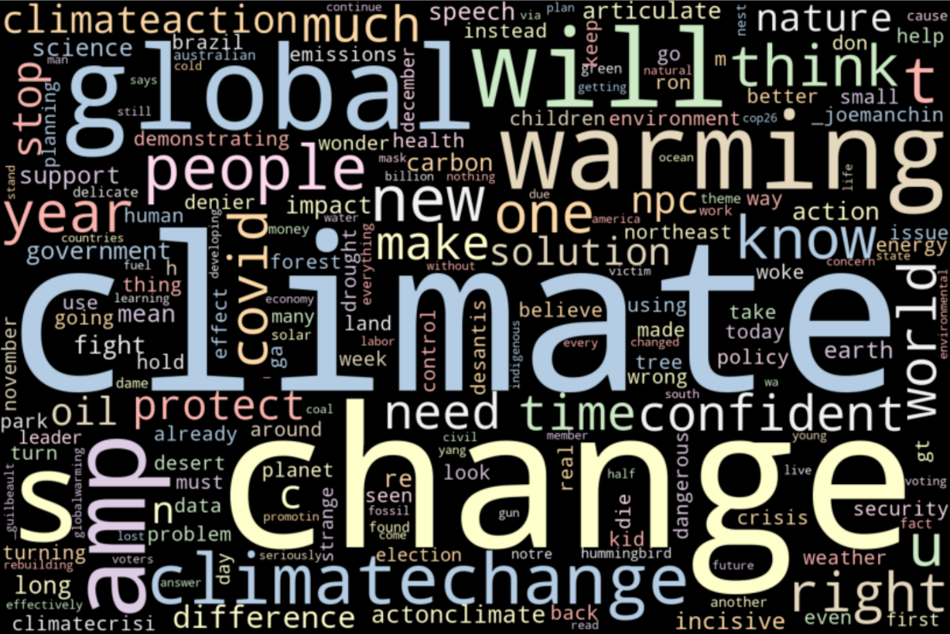
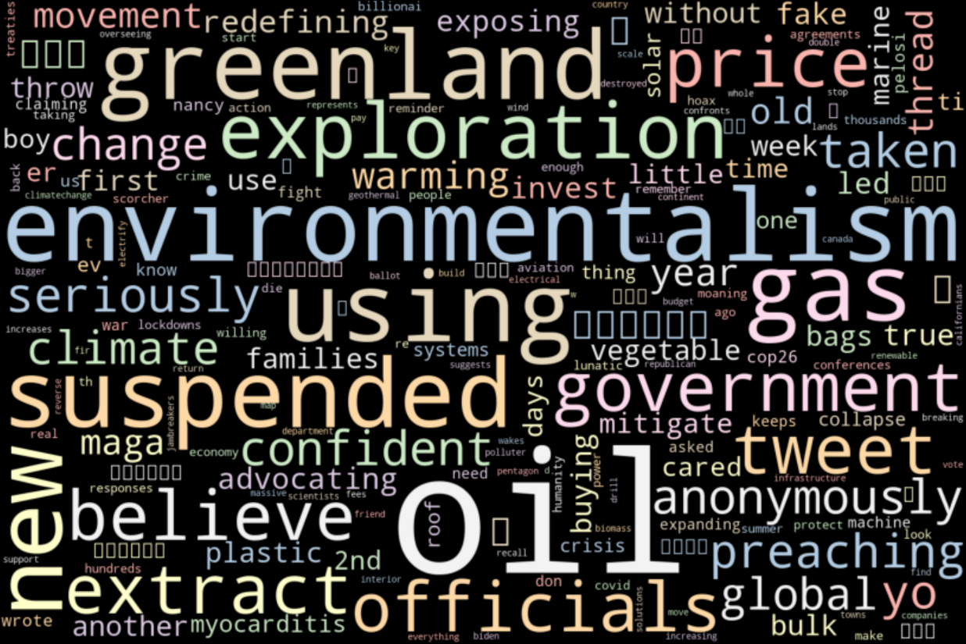
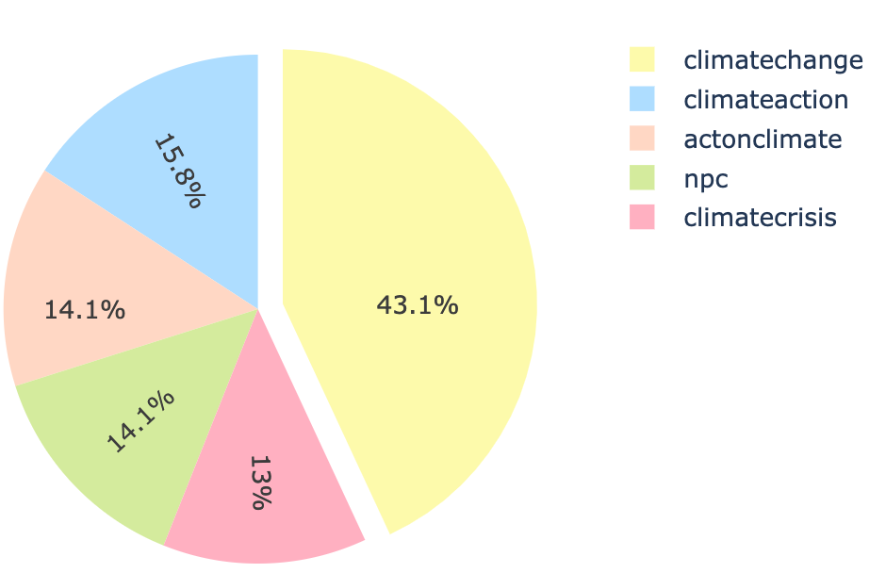
ANALYTICS with VISUALIZATIONS
Q1. The Most Trending Words in the Entire Tweets
Q2. The Most Trending Words in the Top 100 Tweets with the Most Retweets
Q3. Top 5 Most Trending Hashtags
Climate
Change
Global
Warming
World
Oil
Gas
Environmentalism
Greenland
exploration
#ClimateChange
#ClimateAction
#ActionClimate
#NPC
#ClimateCrisis
Notes:
Heesuk

Slide 10
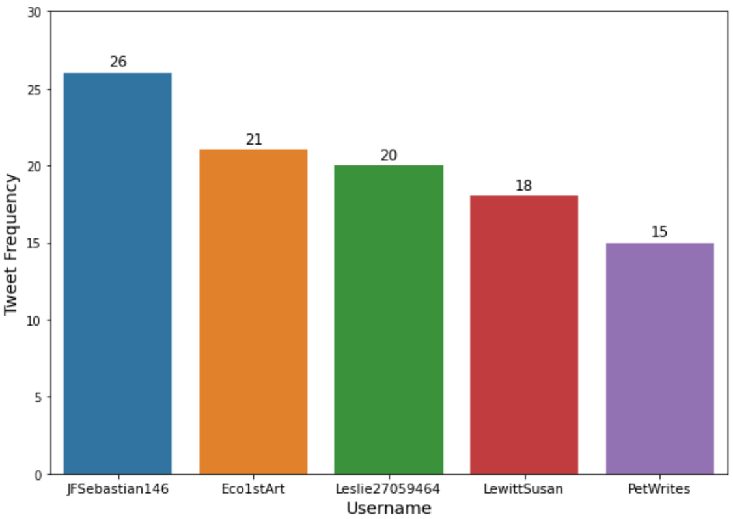
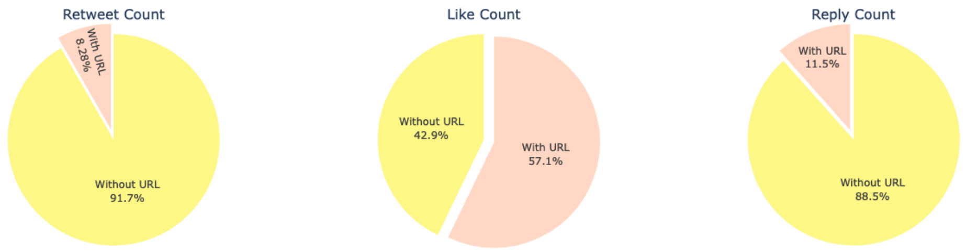
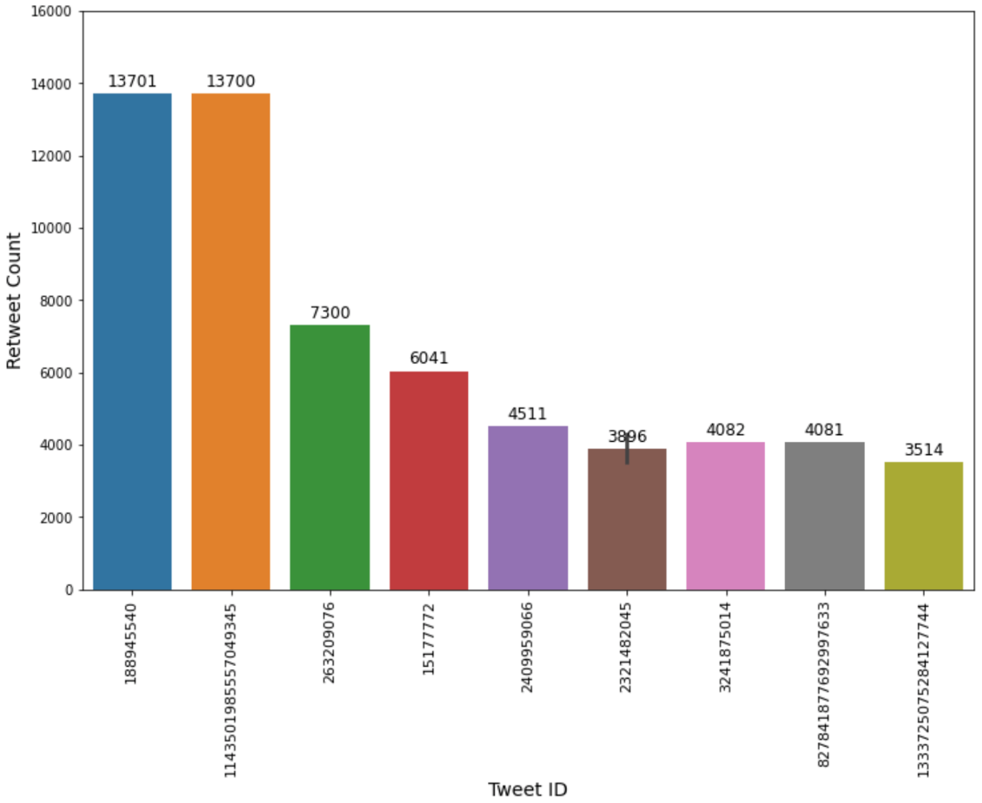
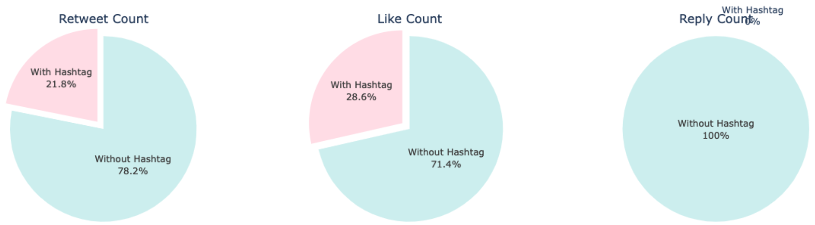
ANALYTICS with VISUALIZATIONS
Q4. Top 5 Most Active Tweeters
Q6. Count of Retweets, Likes, and Replies Having Links
Q5. Top 10 Tweets with the Most Retweets
Q7. Count of Retweets and Likes Having Hashtags
Notes:
Heesuk

